Slide 1

Dictionaries in Python

Slide 2
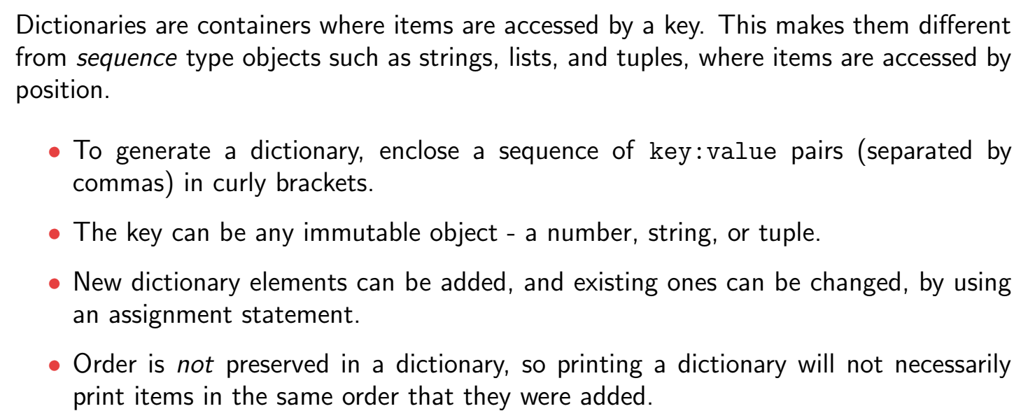
Dictionaries

Slide 3

Dictionaries

Slide 4

Dictionaries

Slide 5

Dictionaries

Slide 6


Dictionaries

Slide 7

Dictionaries

Slide 8

Dictionaries

Slide 9

Dictionaries

Slide 10
Thank You

